Slide 1
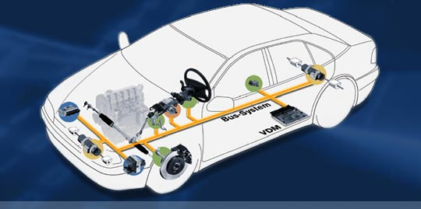
Lecture 19 CAN Introduction
CAN Demo with Two Switches and LEDs
CAN Physical Layer
CAN Introduction
Bus Arbitration
Four Types of Frames
Data, RTT, Error, Overflow
Bit Time
CAN Basics, AN713 from Microchip

Slide 2
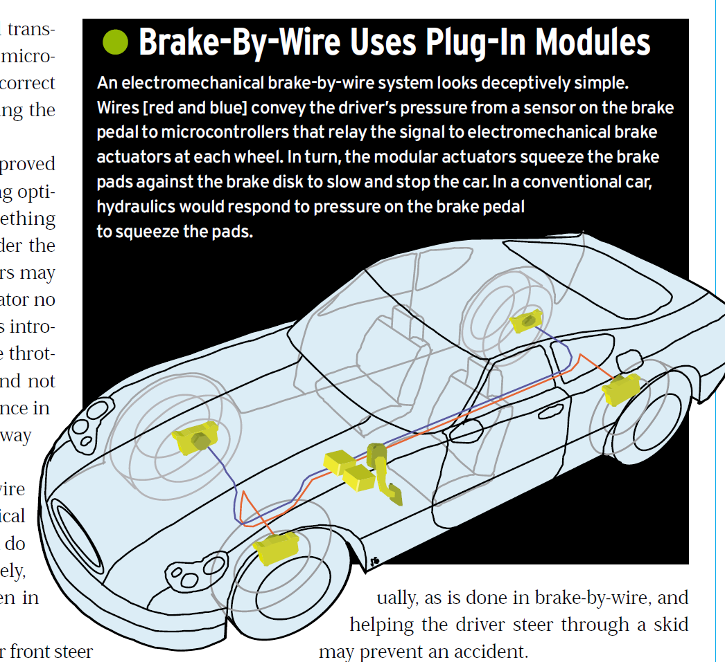
CAN Physical layer

Slide 3
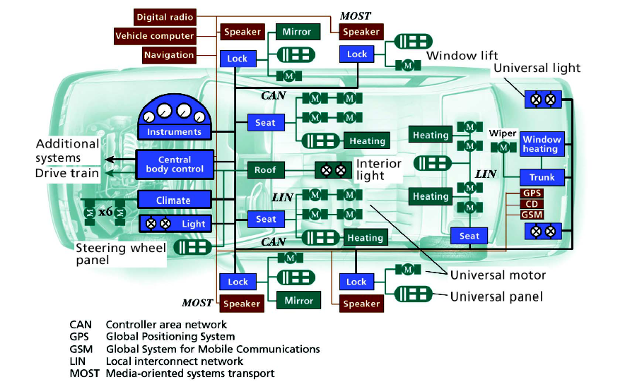
Modern Vehicle’s Network

Slide 4
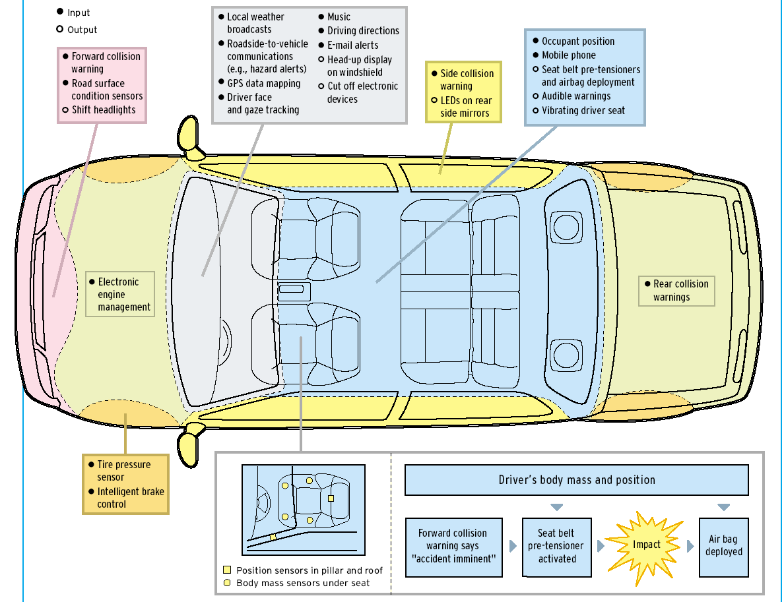
Building Safer Cars (IEEE Spectrum, Jan. 2002)

Slide 5
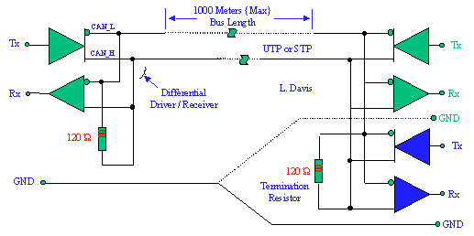
CAN Physical layer
If Tx = 0, CAN_H=HIGH and CAN_L = LOW.
If Tx = 1, both CAN_H and CAN_L are floating.

Slide 6
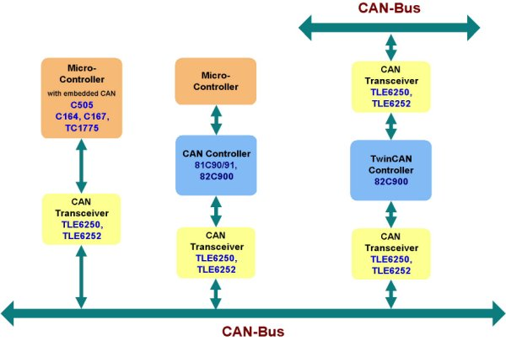
Can-Bus

Slide 8
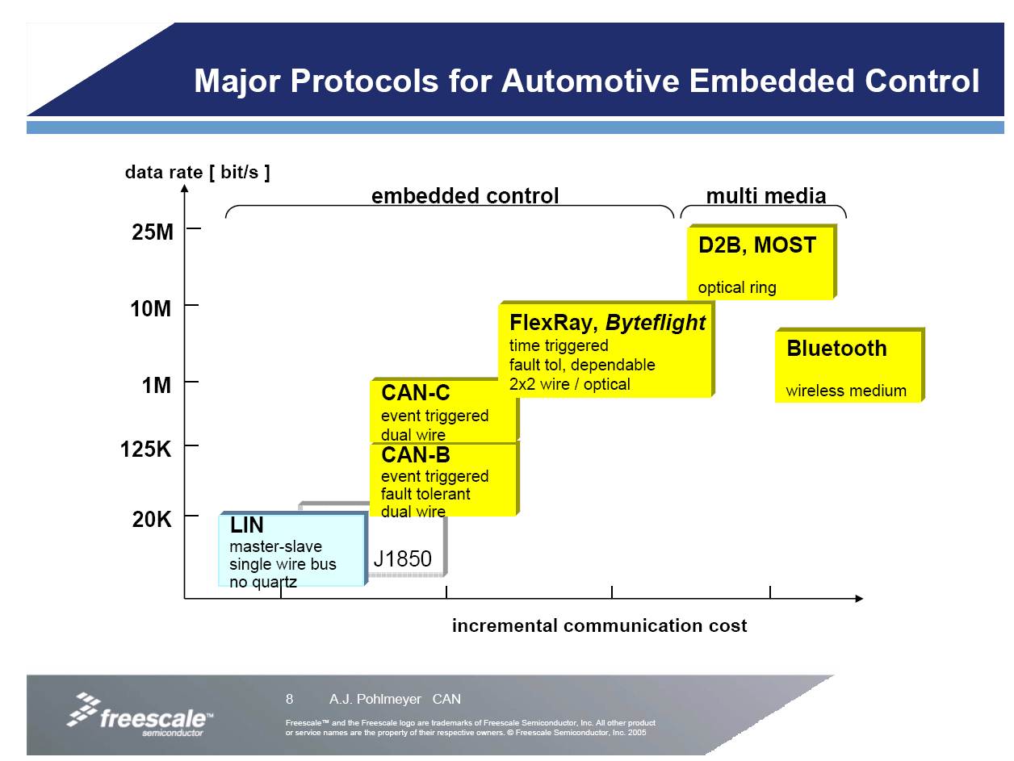

Slide 10
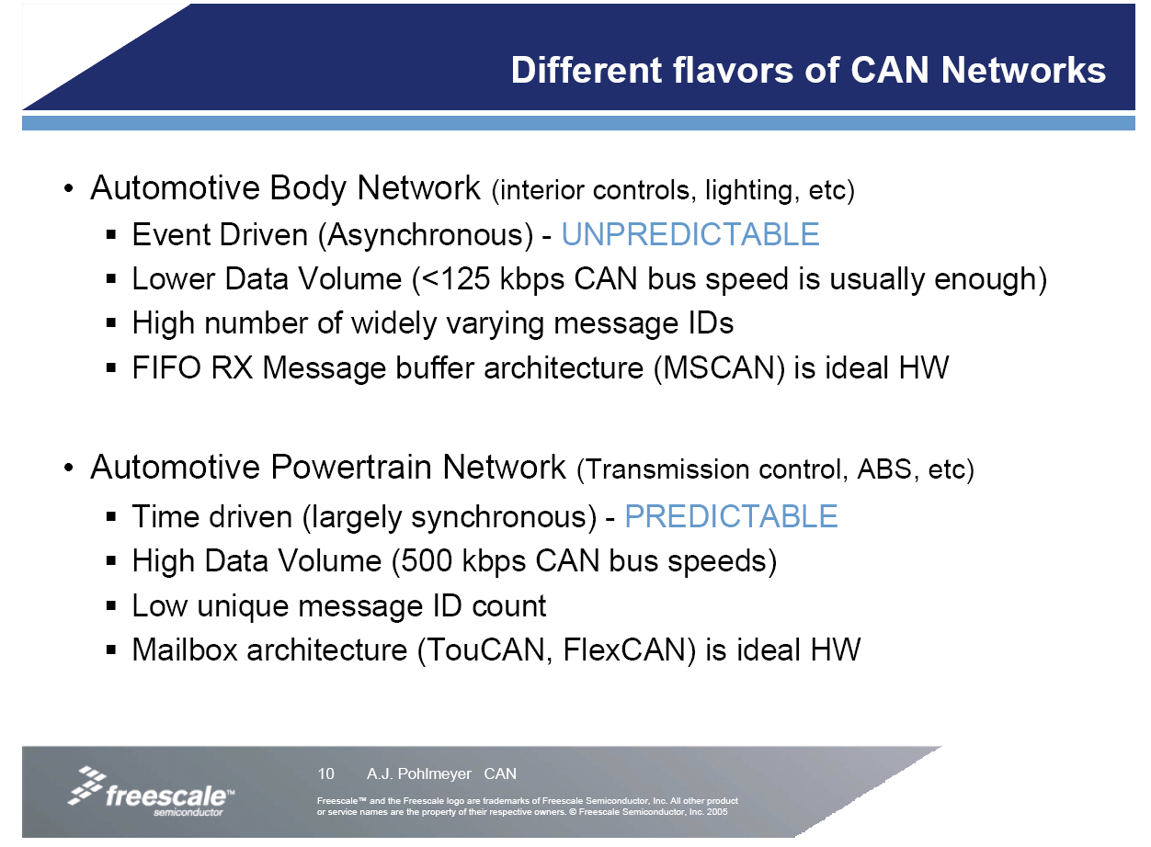

Slide 11
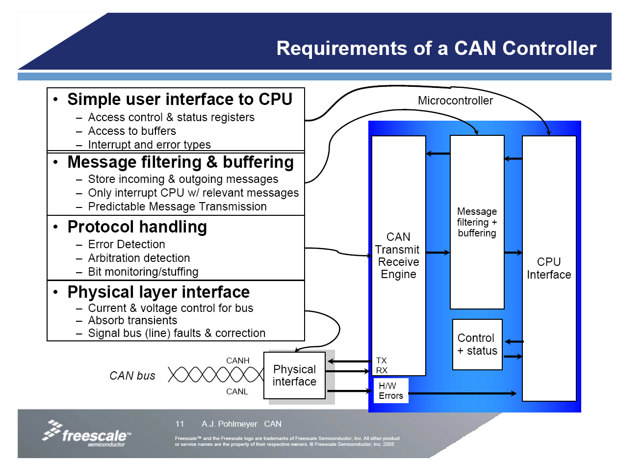

Slide 14
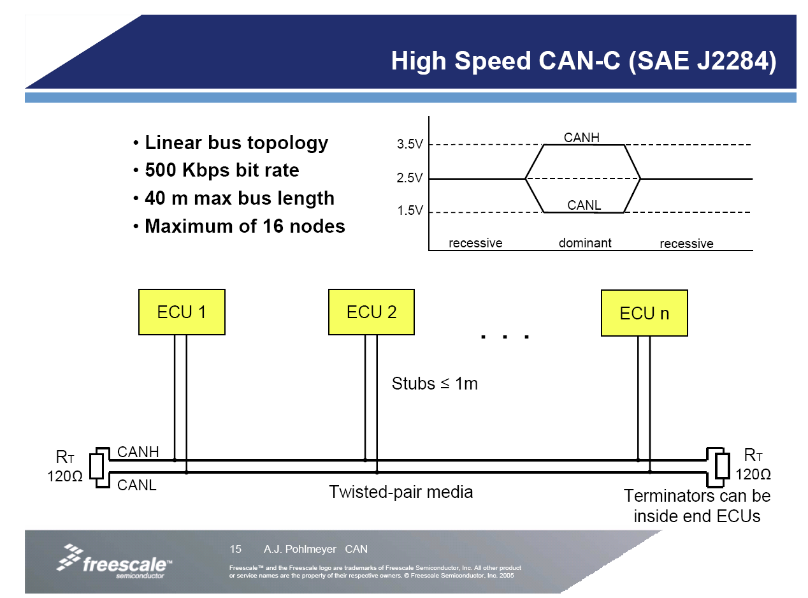

Slide 17
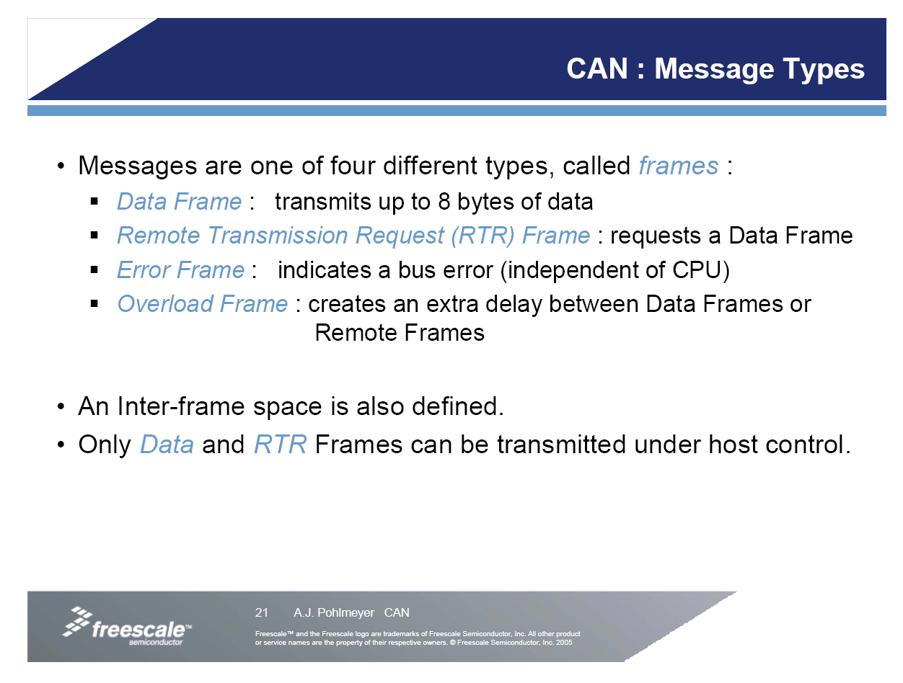

Slide 18
0 is dominant

Slide 20
0 is dominant
1 is recessive, floating the bus

Slide 24
0 is dominant
1 is recessive

Slide 27
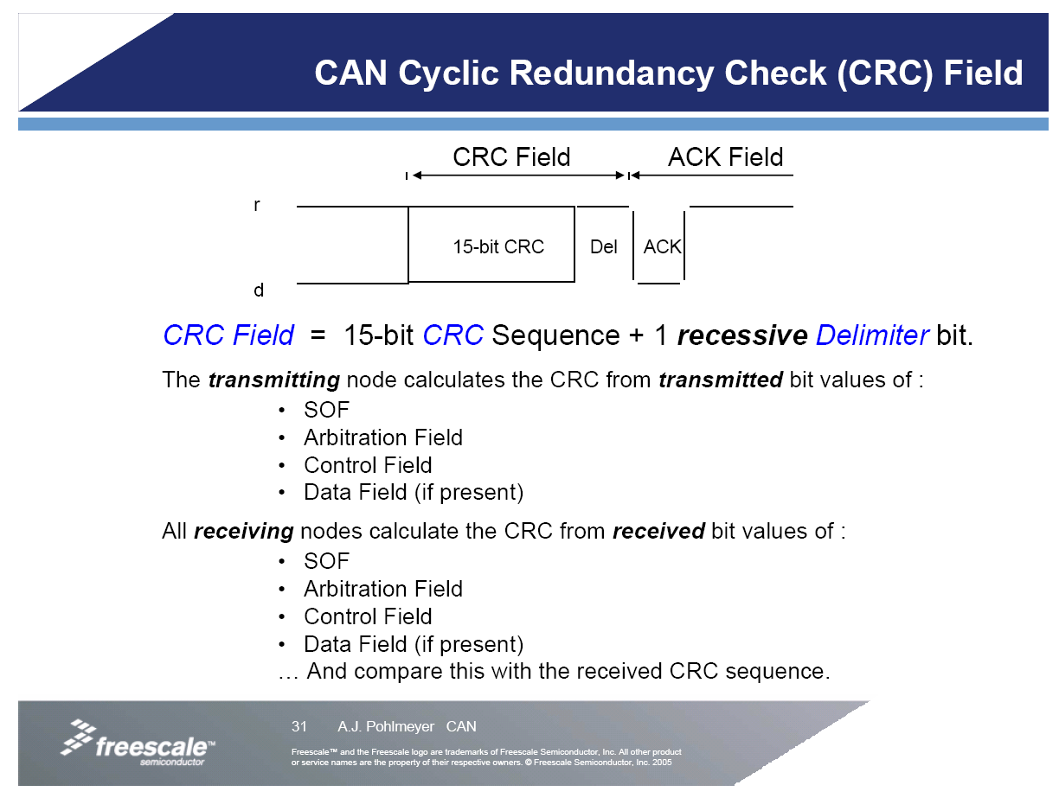

Slide 29
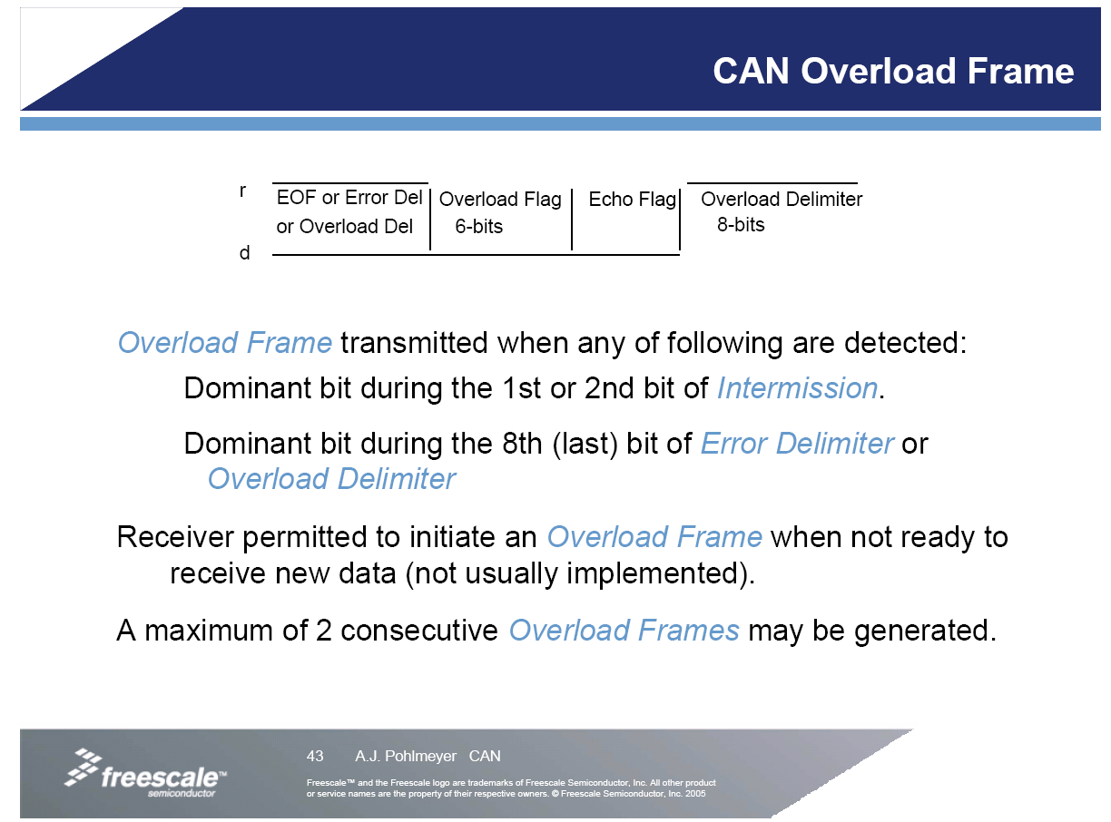

Slide 30
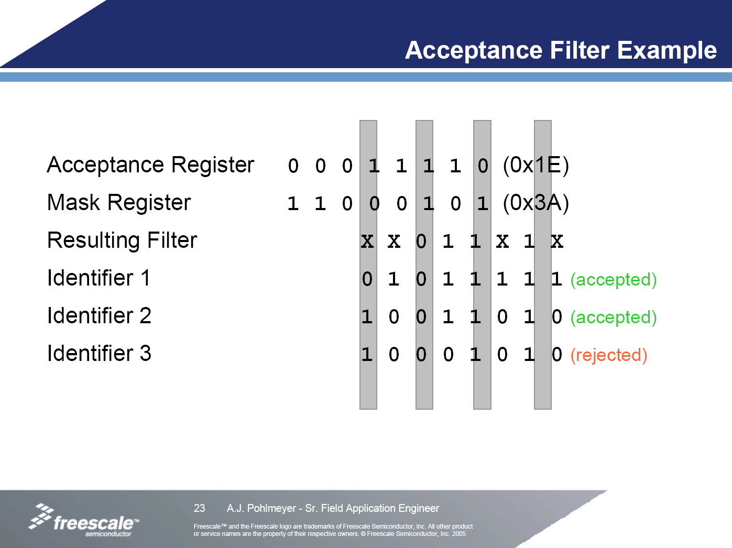
Ignore acceptance bit if it corresponding mask bit is 1

Slide 31
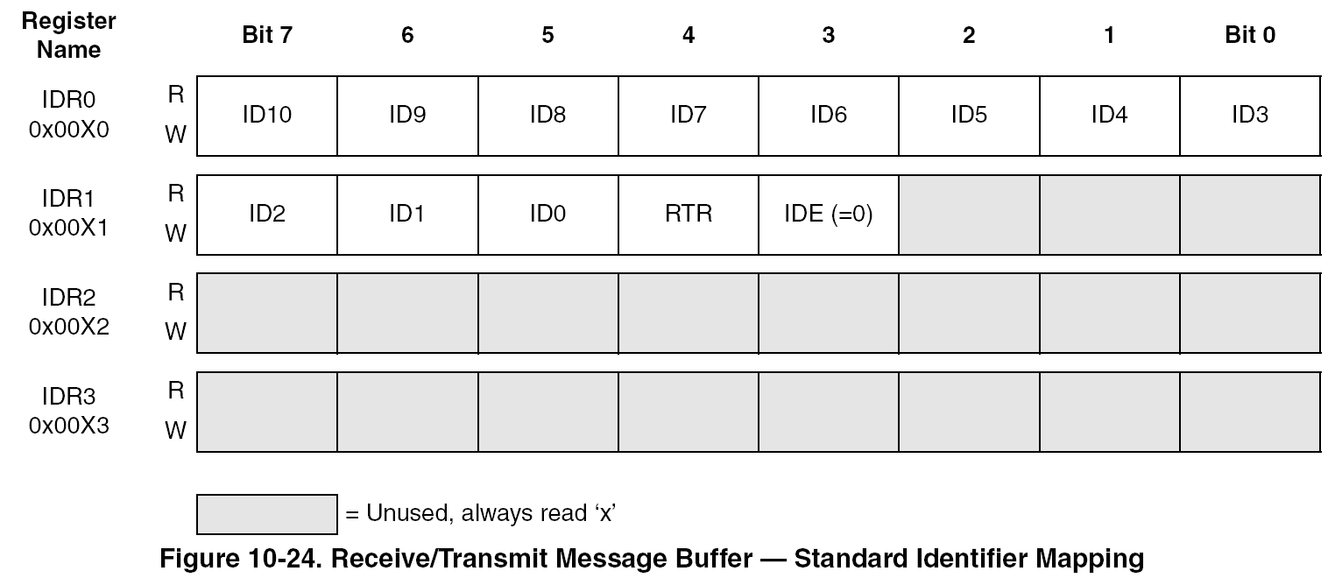
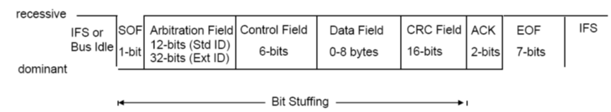
11-Bit Standard Identifier Mapping
11 bit ID
RTR – 0 for data frame and 1 for remote transmit request
IDE – 0 for 11 bit ID

Slide 32
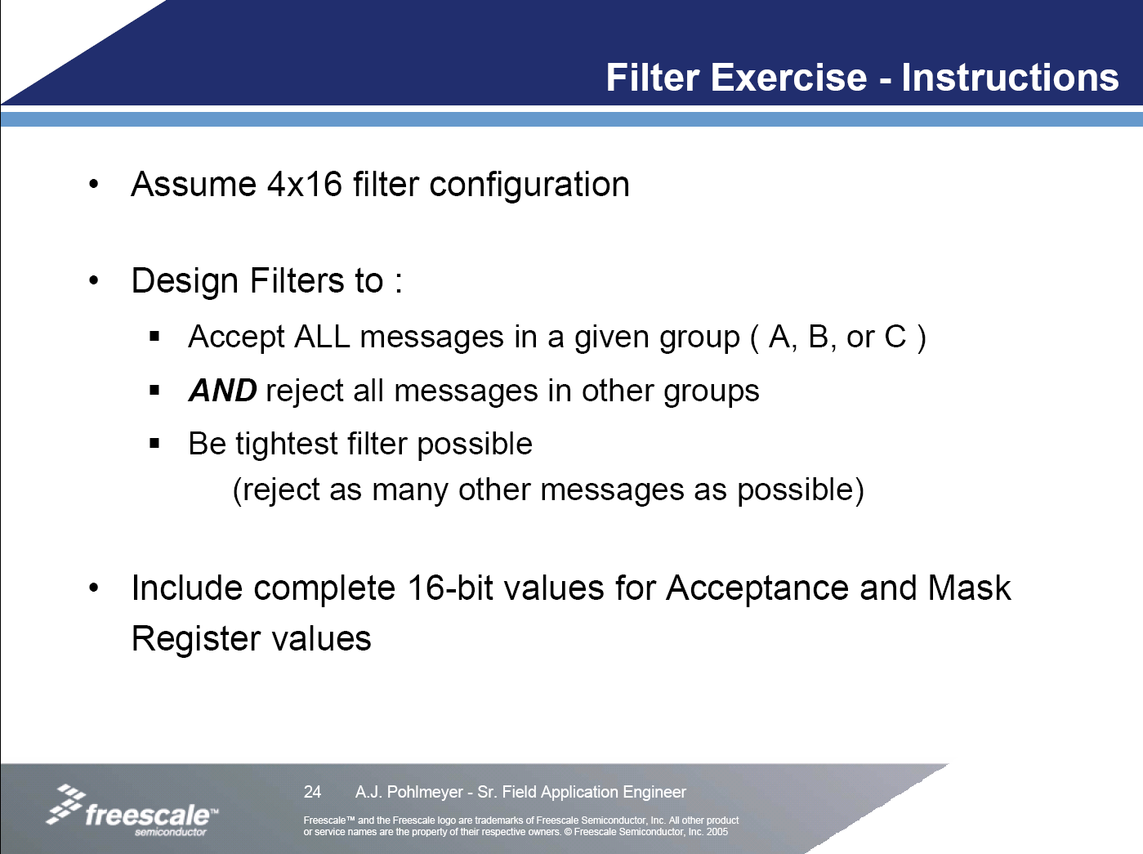

Slide 33
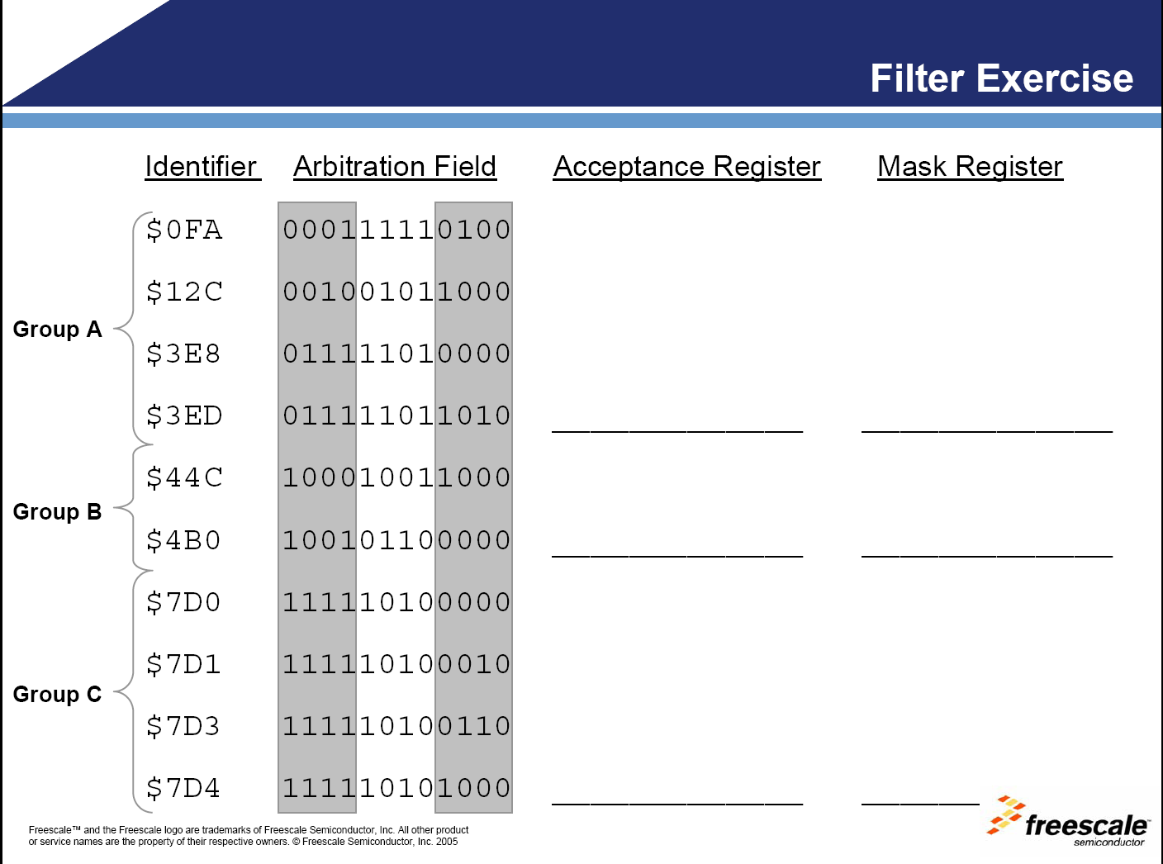

Slide 34
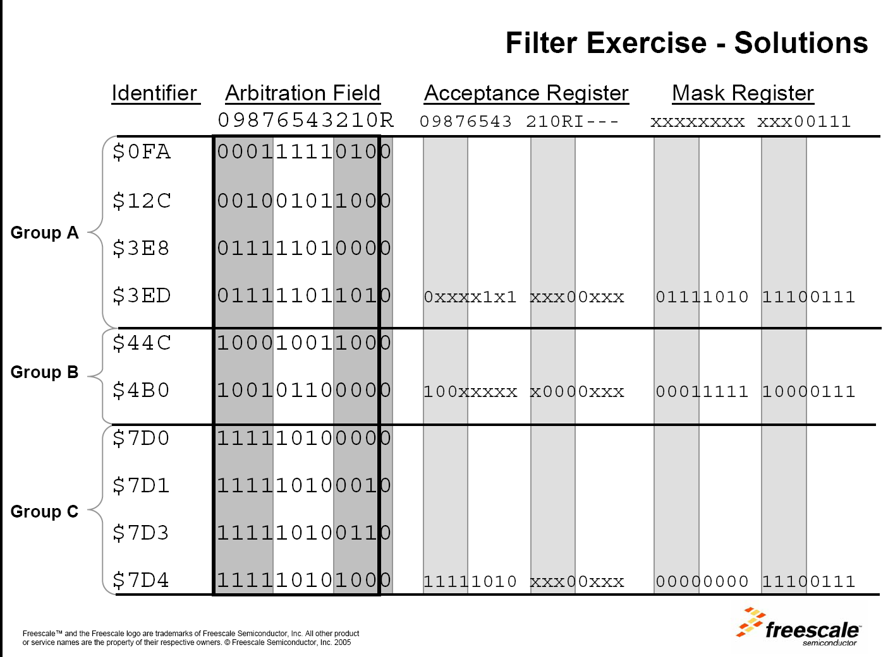

Slide 35
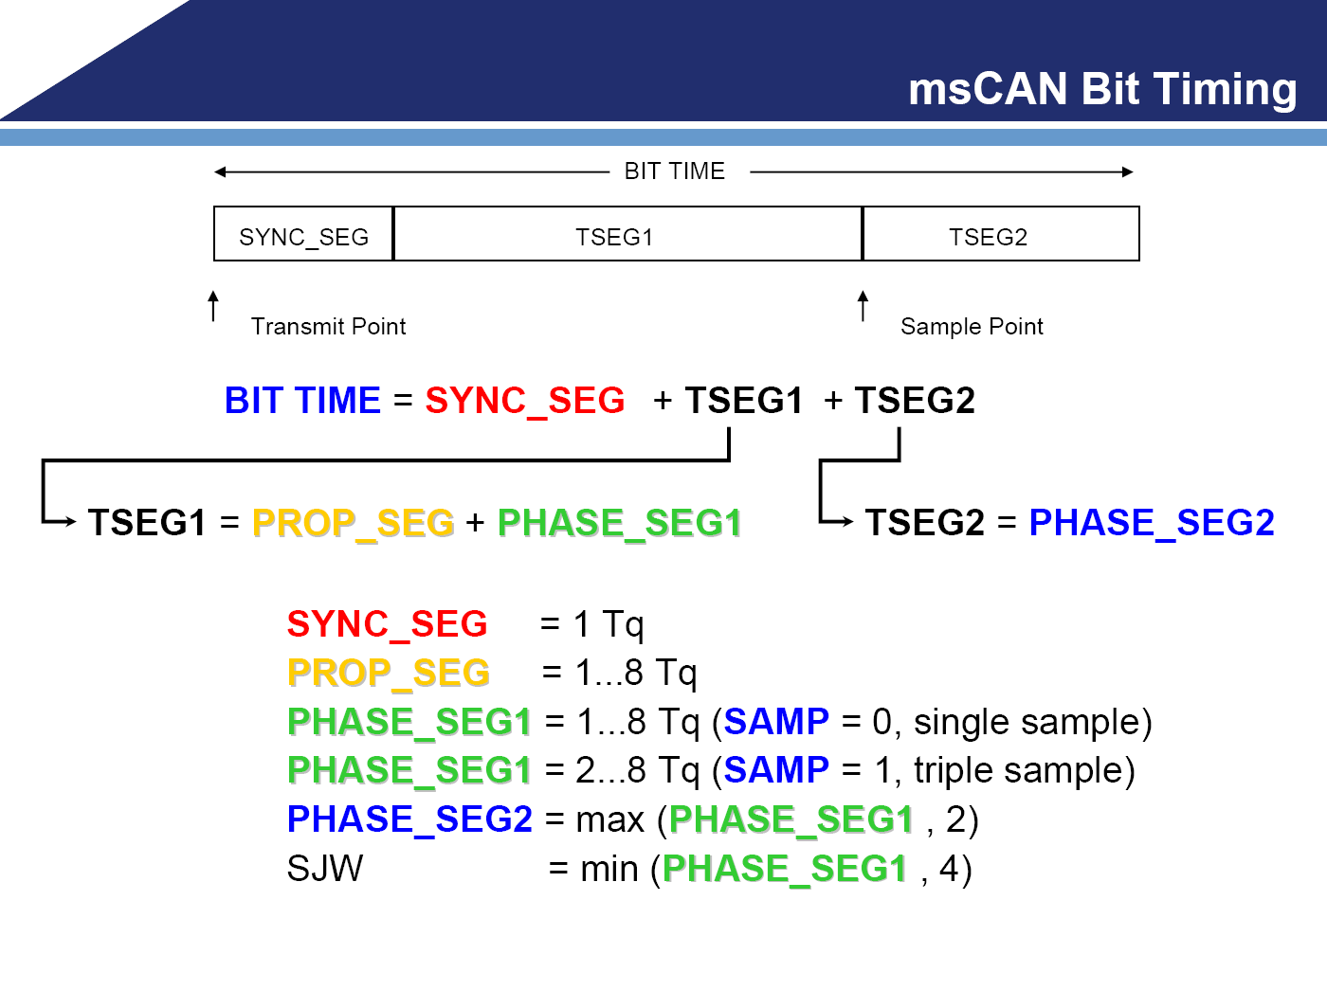

Slide 36
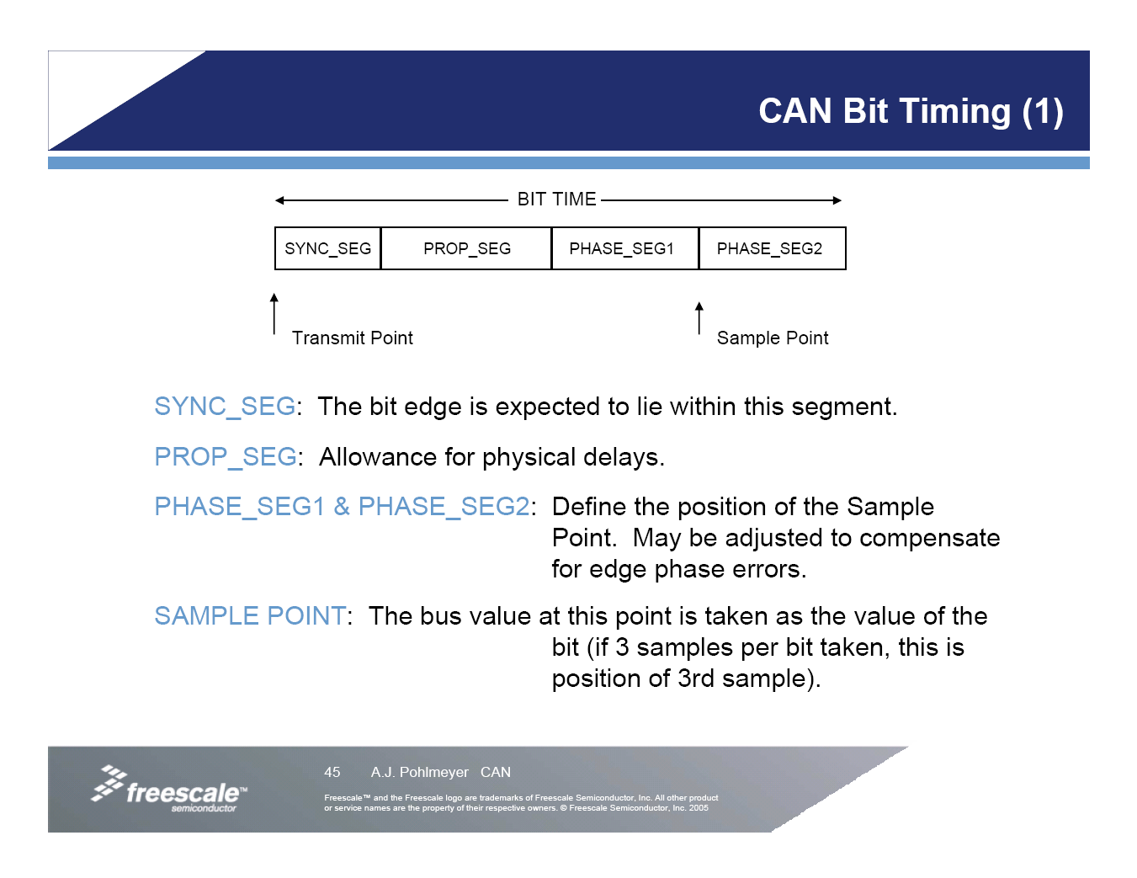

Slide 37
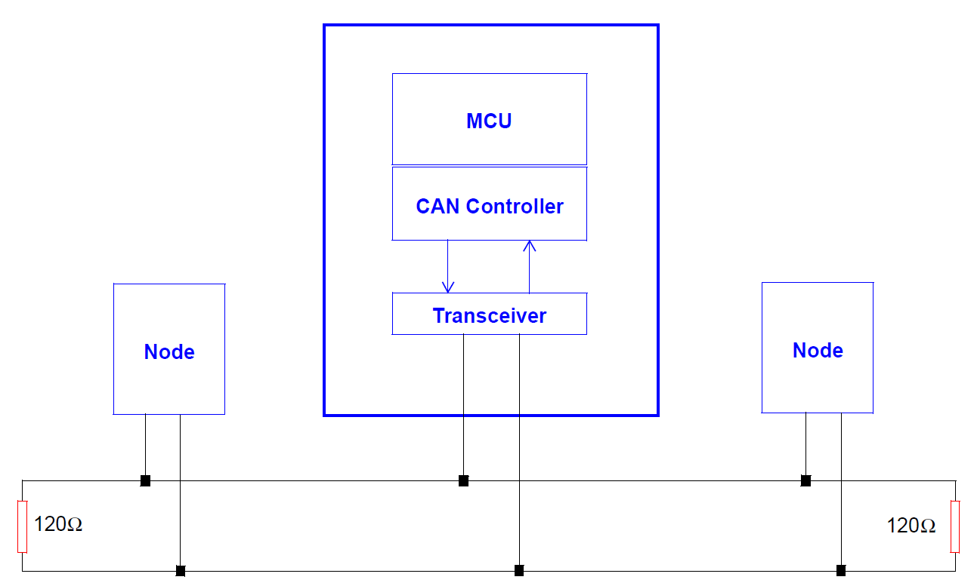
Prog_Seg to Cater to Transmission Line Propagation Delay
Prog_Seg needs to be longer than the round trip delay time of the bus
Two nodes at the far ends need to know if they are competing for the bus. One may start transmitting one transmission line delay before the other starts.

Slide 38
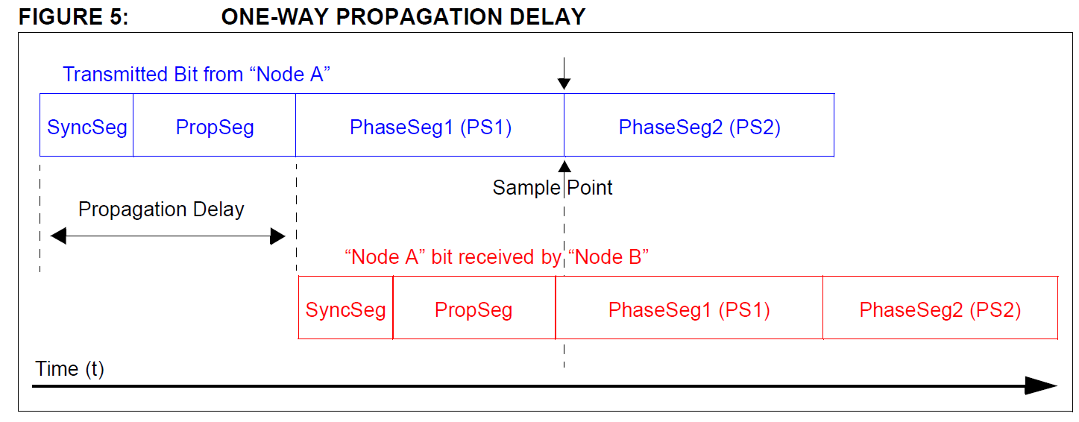
Round Trip Transmission Line Propagation Delay
Two nodes at the far ends need to know if they are competing for the bus. One may start transmitting one transmission line delay before the other starts.

Slide 39
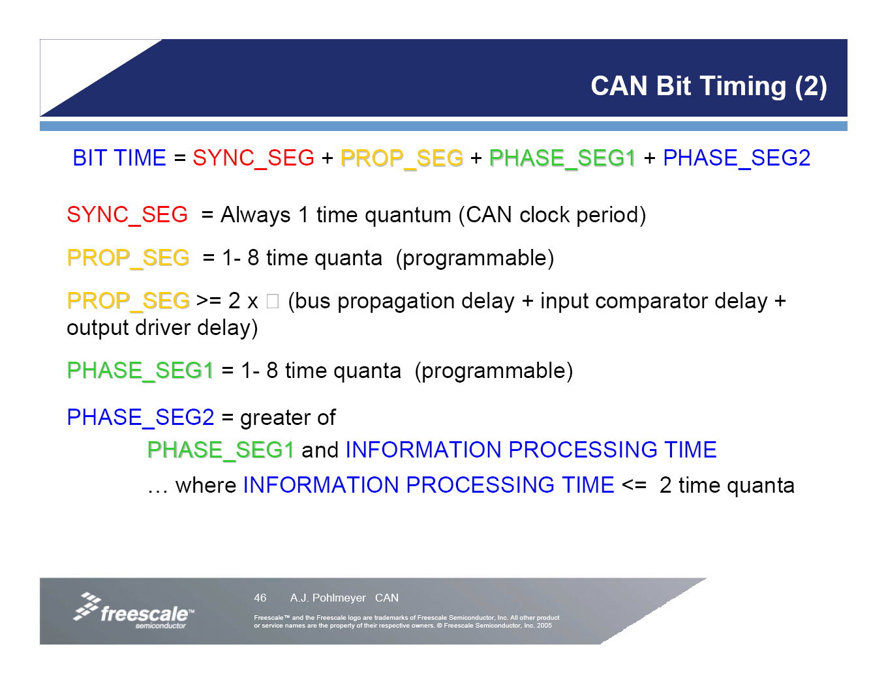

Slide 40
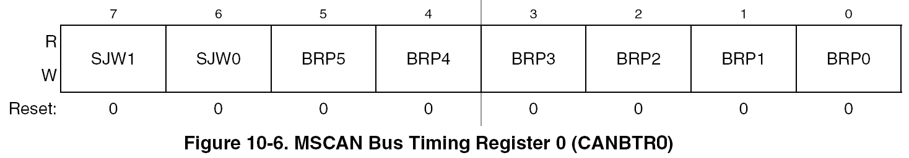
Synchronization Jump Width
SJW[1:0]
The synchronization jump width defines the maximum number of time quanta (Tq) clock cycles a bit can be shortened or lengthened to achieve resynchronization to data transitions on the CAN bus.

Slide 41
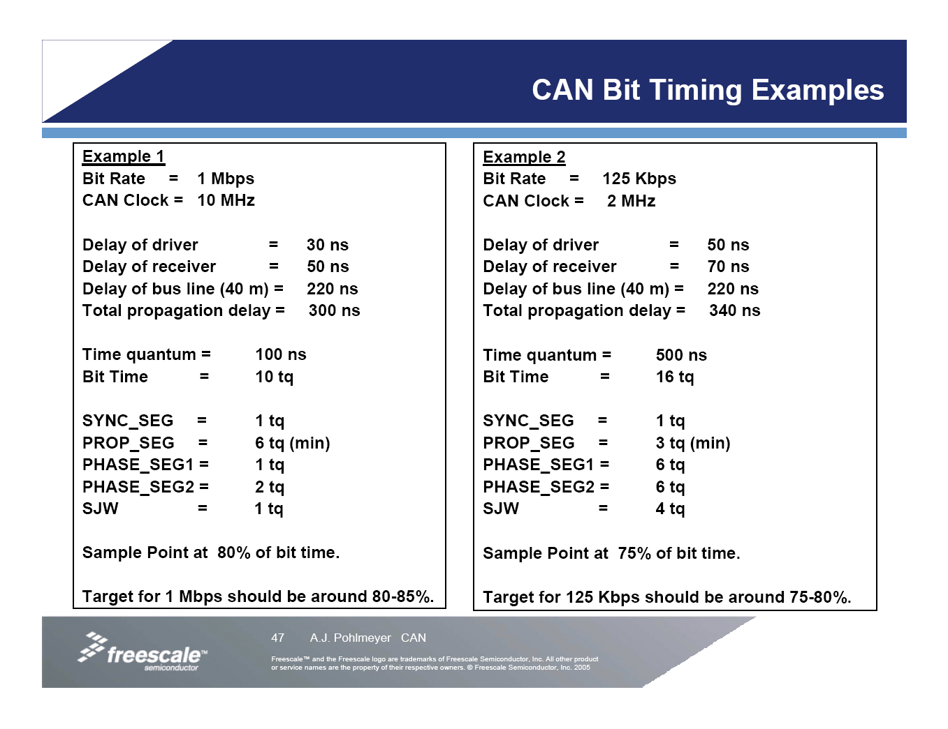

Slide 42
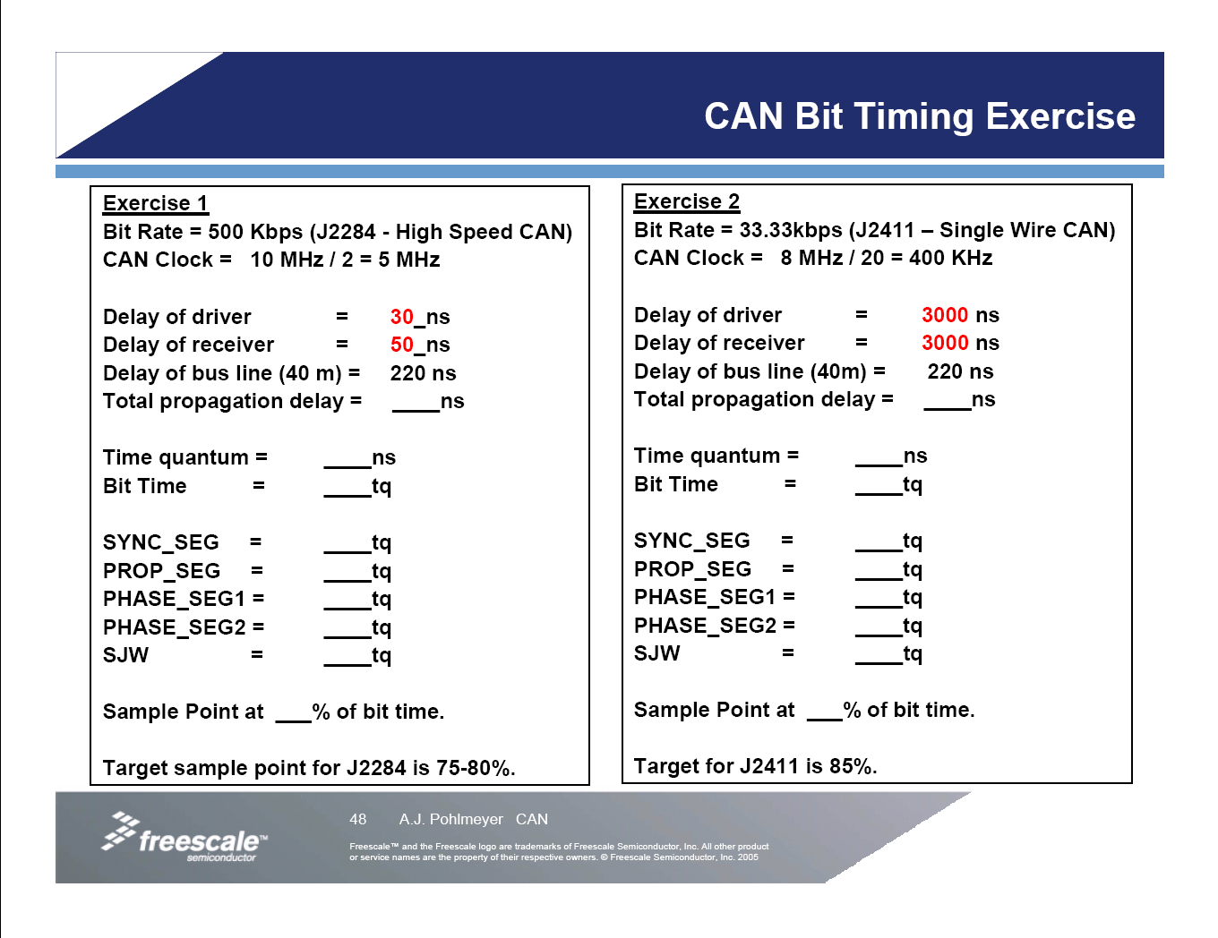

Slide 43
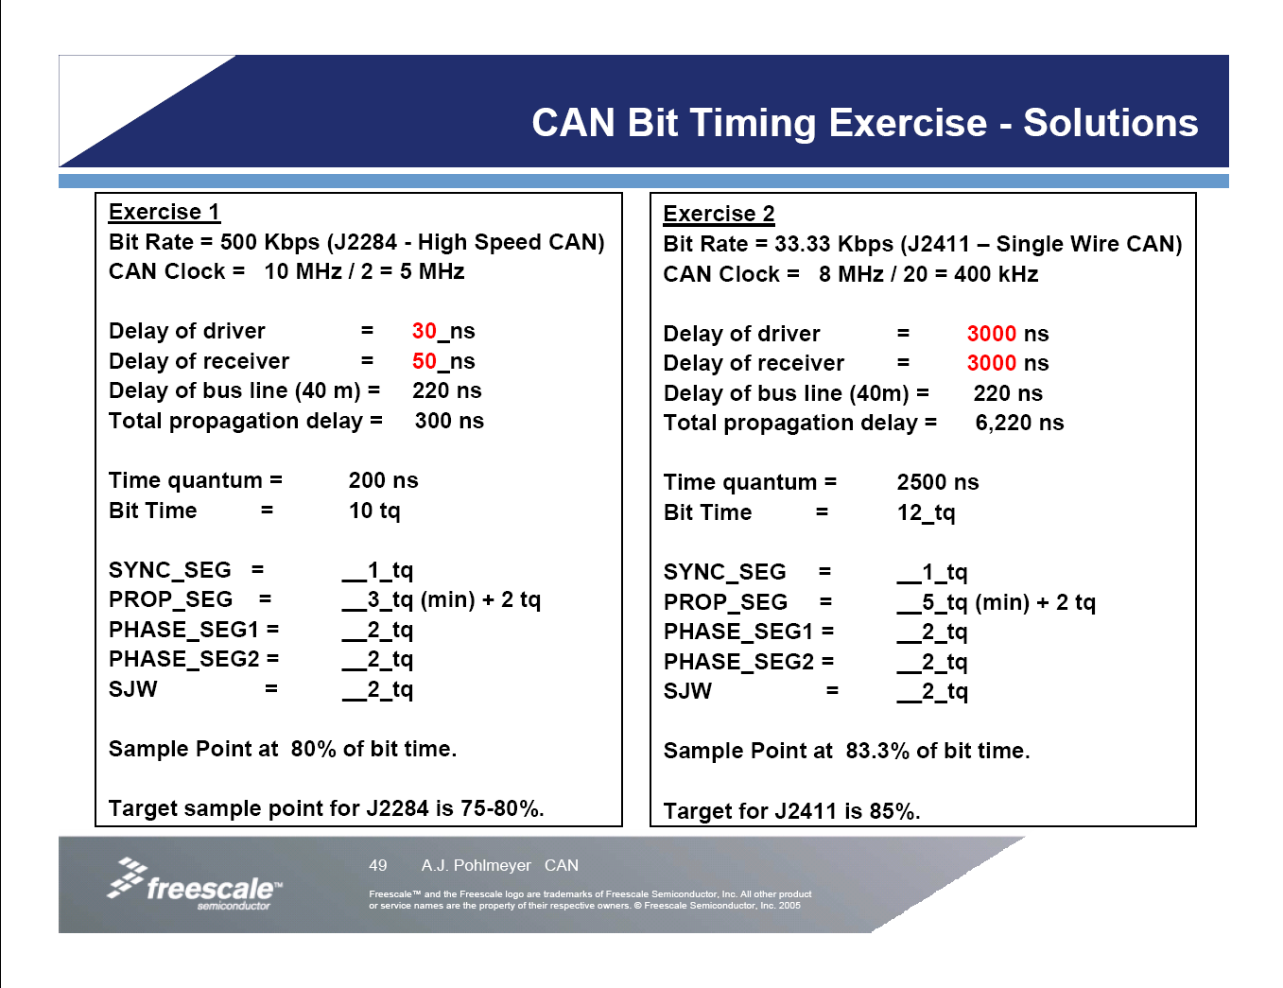

Slide 44
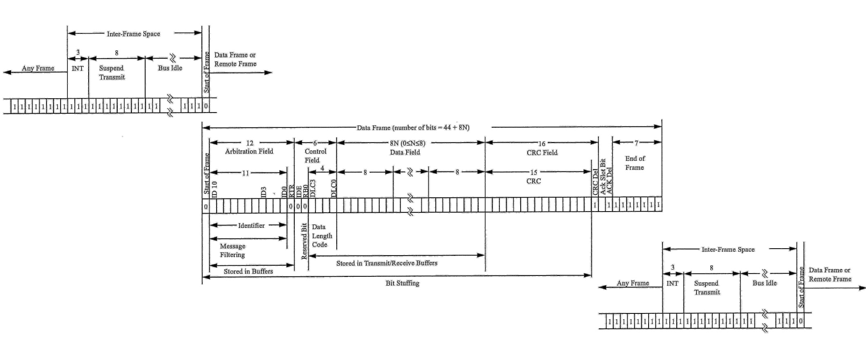
Example Data Frame (AN713, Microchip)

